Slide 1
Indexes

Slide 2
Overview
Introduction
Index types
Multicolumn indexes
Indexes and ORDER BY
Unique indexes
Indexes on Expressions

Slide 3
Index
Indexes are a common way to enhance database performance.
An index allows the database server to find and retrieve specific rows much faster than it could do without an index.
But indexes also add overhead to the database system as a whole, so they should be used sensibly.

Slide 4
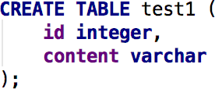
Index
Suppose we have a table similar to this:
and the application issues many queries of the form:

Slide 5
Index
With no advance preparation, the system would have to scan the entire test1 table, row by row, to find all matching entries.
If there are many rows in test1 and only a few rows (perhaps zero or one) that would be returned by such a query, this is clearly an inefficient method.
But if the system has been instructed to maintain an index on the id column, it can use a more efficient method for locating matching rows.

Slide 6
Index
A similar approach is used in most non-fiction books: terms and concepts that are frequently looked up by readers are collected in an alphabetic index at the end of the book.
The interested reader can scan the index relatively quickly and flip to the appropriate page(s), rather than having to read the entire book to find the material of interest.
Just as it is the task of the author to anticipate the items that readers are likely to look up, it is the task of the database programmer to foresee which indexes will be useful.

Slide 7
Index
The following command can be used to create an index on the id column, as discussed:

Slide 8
Index
The name test1_id_index can be chosen freely, but you should pick something that enables you to remember later what the index was for.
To remove an index, use the DROP INDEX command.
Indexes can be added to and removed from tables at any time.

Slide 9
Index
Once an index is created, no further intervention is required
The system will update the index when the table is modified
And it will use the index in queries when it thinks doing so would be more efficient than a sequential table scan.
But you might have to run the ANALYZE command regularly to update statistics to allow the query planner to make educated decisions.

Slide 10
Index
Indexes can also benefit UPDATE and DELETE commands with search conditions.
Indexes can moreover be used in join searches.
Thus, an index defined on a column that is part of a join condition can also significantly speed up queries with joins.

Slide 11
Index
After an index is created, the system has to keep it synchronized with the table.
This adds overhead to data manipulation operations.
Therefore indexes that are seldom or never used in queries should be removed.

Slide 12


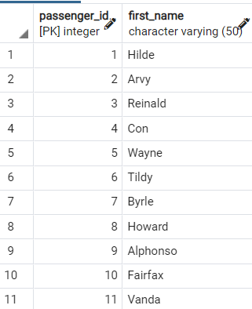
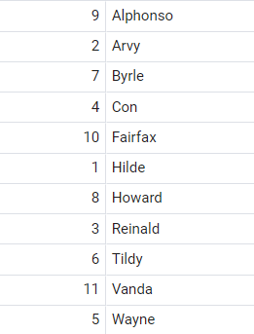
How index works:

Slide 13
Index types
B-tree
Hash
GiST
SP-GiST
GIN
BRIN

Slide 14
Index types
Each index type uses a different algorithm that is best suited to different types of queries.
By default, the CREATE INDEX command creates B-tree indexes, which fit the most common situations.

Slide 15
B-tree index
B-trees can handle equality and range queries on data that can be sorted into some ordering.
PostgreSQL query planner will consider using a B-tree index whenever an indexed column is involved in a comparison using one of these operators:
< <= = >= >

Slide 16
B-tree index
B-tree indexes can also be used to retrieve data in sorted order.
This is not always faster than a simple scan and sort, but it is often helpful.

Slide 17
Hash index
Hash indexes can only handle simple equality comparisons.
The query planner will consider using a hash index whenever an indexed column is involved in a comparison using the = operator. The following command is used to create a hash index:

Slide 18
GiST index
GiST indexes are not a single kind of index, but rather an infrastructure within which many different indexing strategies can be implemented.
Accordingly, the particular operators with which a GiST index can be used vary depending on the indexing strategy (the operator class).
<< &< &> >> <<| &<| |&> |>> @> <@ ~= &&

Slide 19
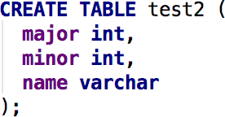
Multicolumn Indexes
An index can be defined on more than one column of a table. For example, if you have a table of this form:
and you frequently issue queries like:

Slide 20
Multicolumn Indexes
then it might be appropriate to define an index on the columns major and minor together, e.g.:
Up to 32 columns can be specified. (This limit can be altered when building PostgreSQL; see the
file pg_config_manual.h.)

Slide 21
Indexes and ORDER BY
In addition to simply finding the rows to be returned by a query, an index may be able to deliver them in a specific sorted order.
only B-tree can produce sorted output
By default, B-tree indexes store their entries in ascending order with nulls last.

Slide 22
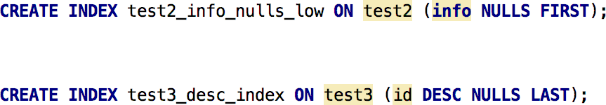
Indexes and ORDER BY
You can adjust the ordering of a B-tree index by including the options ASC, DESC, NULLS FIRST, and/or NULLS LAST when creating the index; for example:

Slide 23
Unique Indexes
Indexes can also be used to enforce uniqueness of a column's value, or the uniqueness of the combined values of more than one column.
Currently, only B-tree indexes can be declared unique.

Slide 24
Unique Indexes
When an index is declared unique, multiple table rows with equal indexed values are not allowed.
Null values are not considered equal.
A multicolumn unique index will only reject cases where all indexed columns are equal in multiple rows.

Slide 25
Unique Indexes
PostgreSQL automatically creates a unique index when a unique constraint or primary key is defined for a table.
The index covers the columns that make up the primary key or unique constraint (a multicolumn index, if appropriate), and is the mechanism that enforces the constraint.

Slide 26
Indexes on Expressions
An index column need not be just a column of the underlying table, but can be a function or scalar expression computed from one or more columns of the table.
This feature is useful to obtain fast access to tables based on the results of computations.

Slide 27
Indexes on Expressions
For example, a common way to do case-insensitive comparisons is to use the lower function:
This query can use an index if one has been defined on the result of the lower(col1) function:

Slide 28
Indexes on Expressions

Slide 29
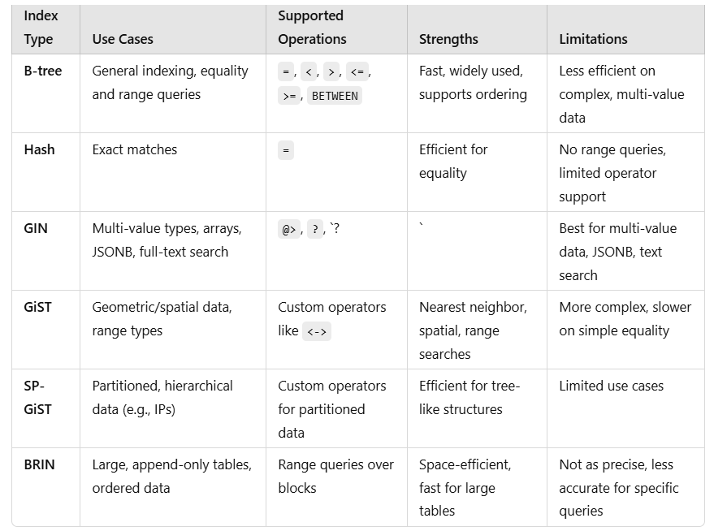

Slide 30
Examples
B-tree index for flight search
After indexing, queries will run faster because they won't require a full table scan.

Slide 31
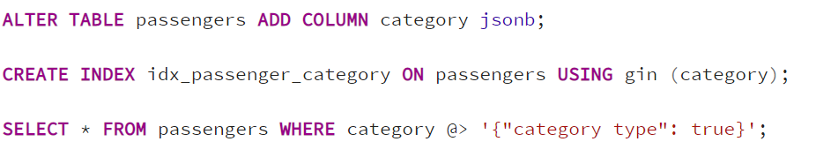
GIN index

Slide 32
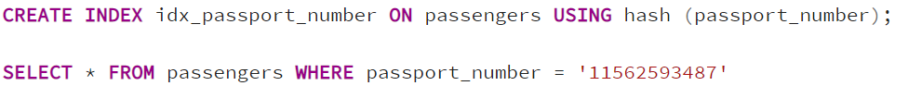
Hash index

Slide 33


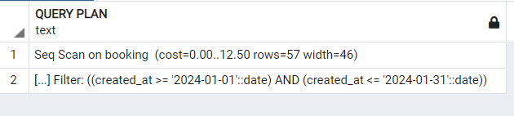
BRIN index

Slide 34
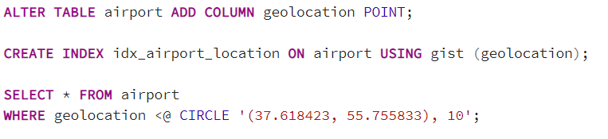
GiST index

Slide 35
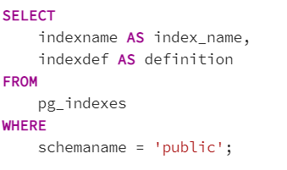
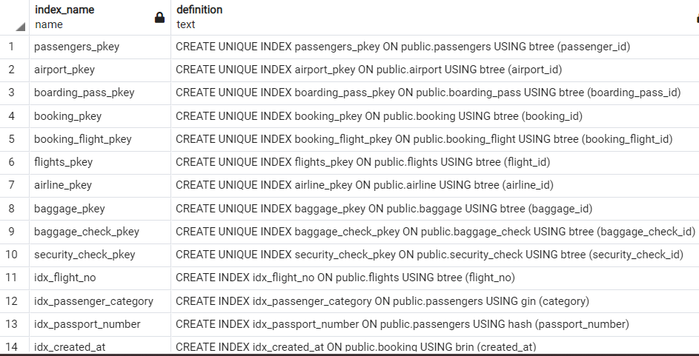
Show all indexes of a database

Slide 36
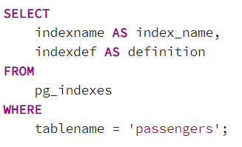
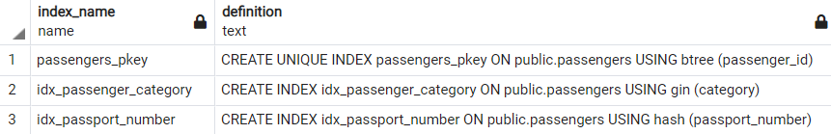
Show all indexes of a table

Slide 37
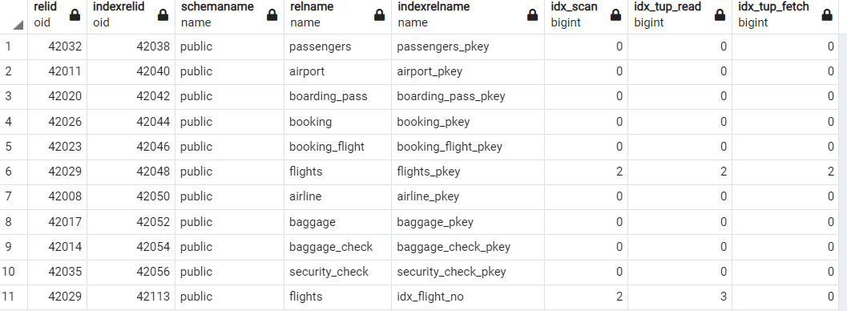
Monitoring index usage

Slide 38
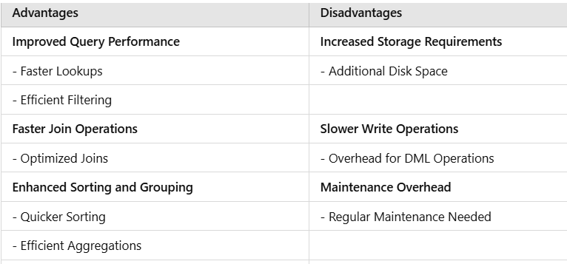
Summary

